Slide 1
Generalization and Function Approximation
AINT351 Machine Learning

Slide 2
RL so far…
Identifying optimal policies
T available
Dynamic Programming
Optimal policies from experience
Monte-Carlo
Temporal Difference (α)
Improving learning using modelling and planning
Learning in complex and continuous domains
Next: Learning with partial observabilities (POMDPs)

Slide 3
Table-Based Solutions
Transition Function
11x11x4 table
Policy
11x4 table
State-Value Function
11 vector
State-Action-Value Function (Q-values)
11x4 table

Slide 4
Table Limitations
Only works for small numbers of states and actions
Large amount of memory needed for large tables
Long time needed to fill table in accurately
Generalisation
Use experience with limited subset of state space
Approximate much larger subset of state space
Continuous values
Must always generalise

Slide 5
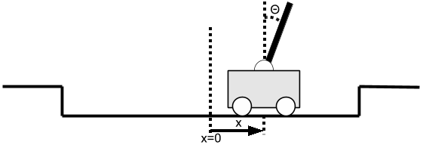
Discretization
By hand
Arbitrary
Automated
Unsupervised learning
Clustering criteria not necessarily conducive to learning

Slide 6
Function Approximation
Approximates a function from a subset of inputs and outputs
Supervised learning
Linear Regression
Regression Trees
Artificial Neural Networks
Combined with RL
State Value Function Approximation
State-Action Value Function Approximation

Slide 7
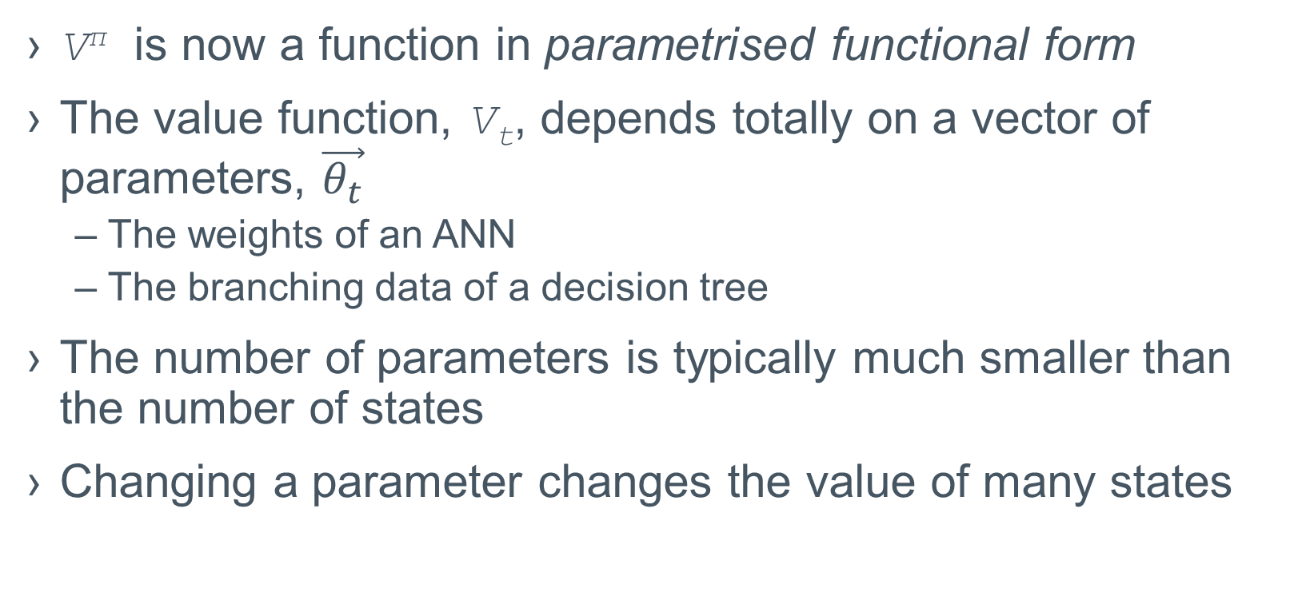
Value Prediction with Function Approximation
V^{π} is now a function in parametrised functional form
The value function, V_{t}, depends totally on a vector of parameters, $\vec{θ_{t}}$
The weights of an ANN
The branching data of a decision tree
The number of parameters is typically much smaller than the number of states
Changing a parameter changes the value of many states

Slide 8
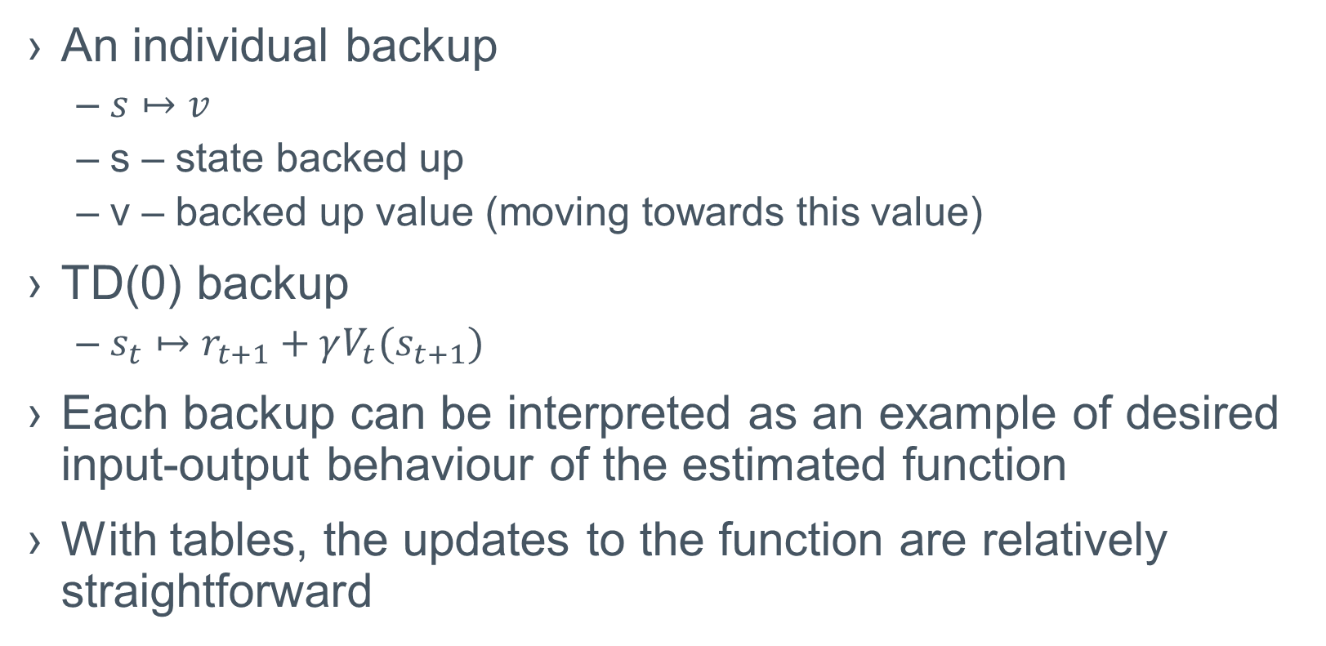
Backups
An individual backup
$s↦v$
s – state backed up
v – backed up value (moving towards this value)
TD(0) backup
$s_{t}↦r_{t+1}+γV_{t}(s_{t+1})$
Each backup can be interpreted as an example of desired input-output behaviour of the estimated function
With tables, the updates to the function are relatively straightforward

Slide 9
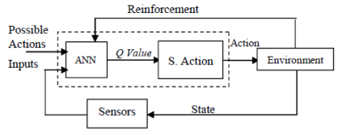
Using Neural Networks for the Value Function
Q value f multiple state and action combinations
Update function based on experience
Error: Q(s, a)-Q’(s, a)

Slide 10
Suitable Function Approximation Methods
Most classifiers assume a static training set
Multiple passes over the training set is common
In RL, learning must be online
Incrementally acquired data
Non-persistent data
In RL we also typically have nonstationary target functions
Bootstrapping means target function is changing
Approximators must be able to handle this

Slide 11
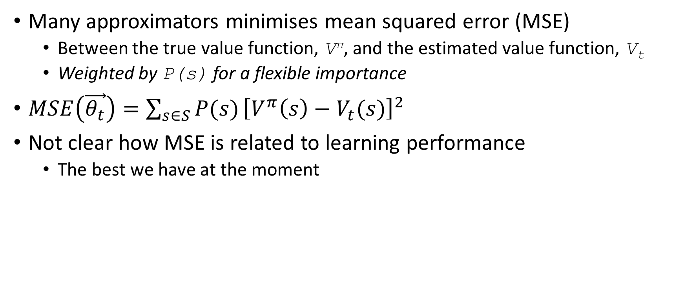
Evaluating Function Approximators
Many approximators minimises mean squared error (MSE)
Between the true value function, V^{π}, and the estimated value function, V_{t}
Weighted by P(s) for a flexible importance
$MSE\left(\vec{θ_{t}}\right)=\sum_{s∈S}{P(s)}{\left[V^{π}\left(s\right)−V_{t}(s)\right]}^{2}$
Not clear how MSE is related to learning performance
The best we have at the moment

Slide 12
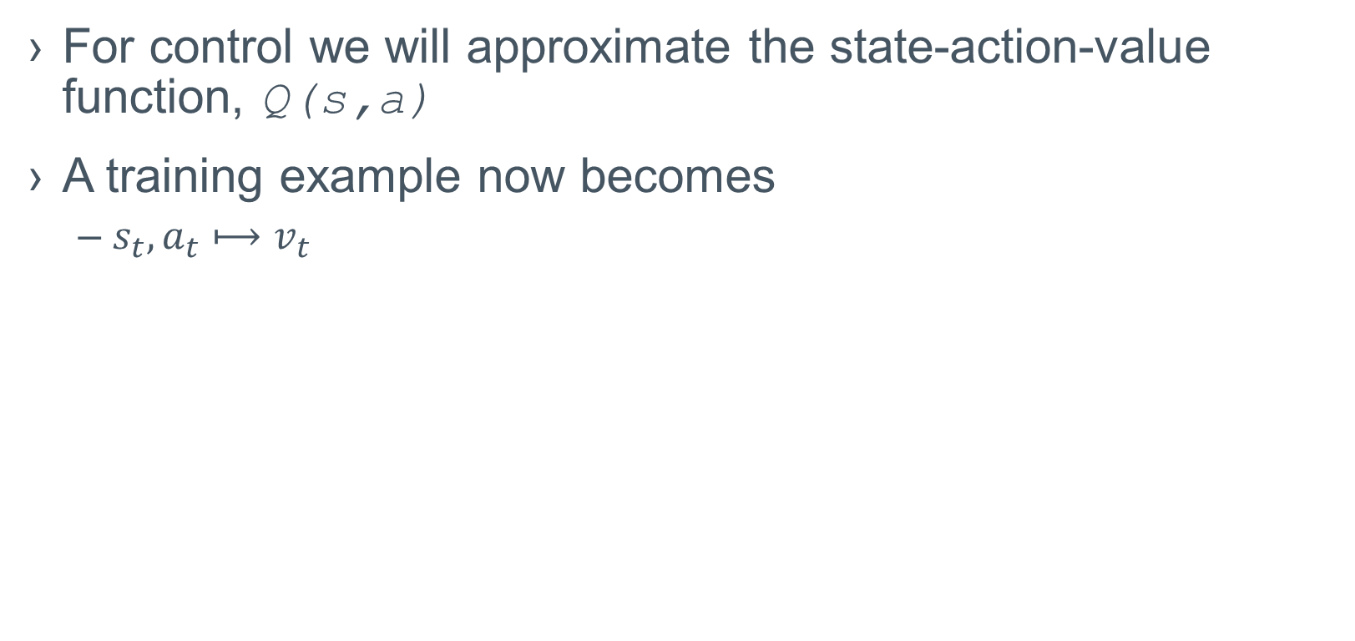
Control with Function Approximation
For control we will approximate the state-action-value function, Q(s,a)
A training example now becomes
$s_{t},a_{t}⟼v_{t}$

Slide 13
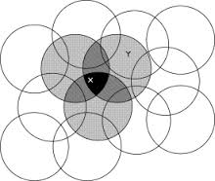
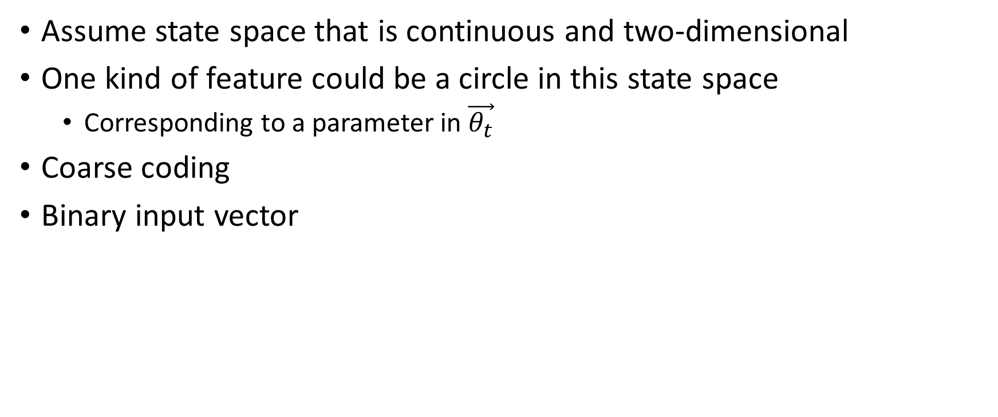
State Space Coding
Assume state space that is continuous and two-dimensional
One kind of feature could be a circle in this state space
Corresponding to a parameter in $\vec{θ_{t}}$
Coarse coding
Binary input vector

Slide 14
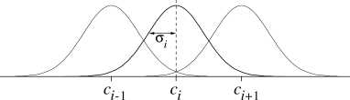
Radial Basis Functions
RBFs are a natural extension of coarse coding
A collection of Gaussians
The value of each feature varies with the distance from the mean for that feature
Value between 0.0 and 1.0

